Slide 1
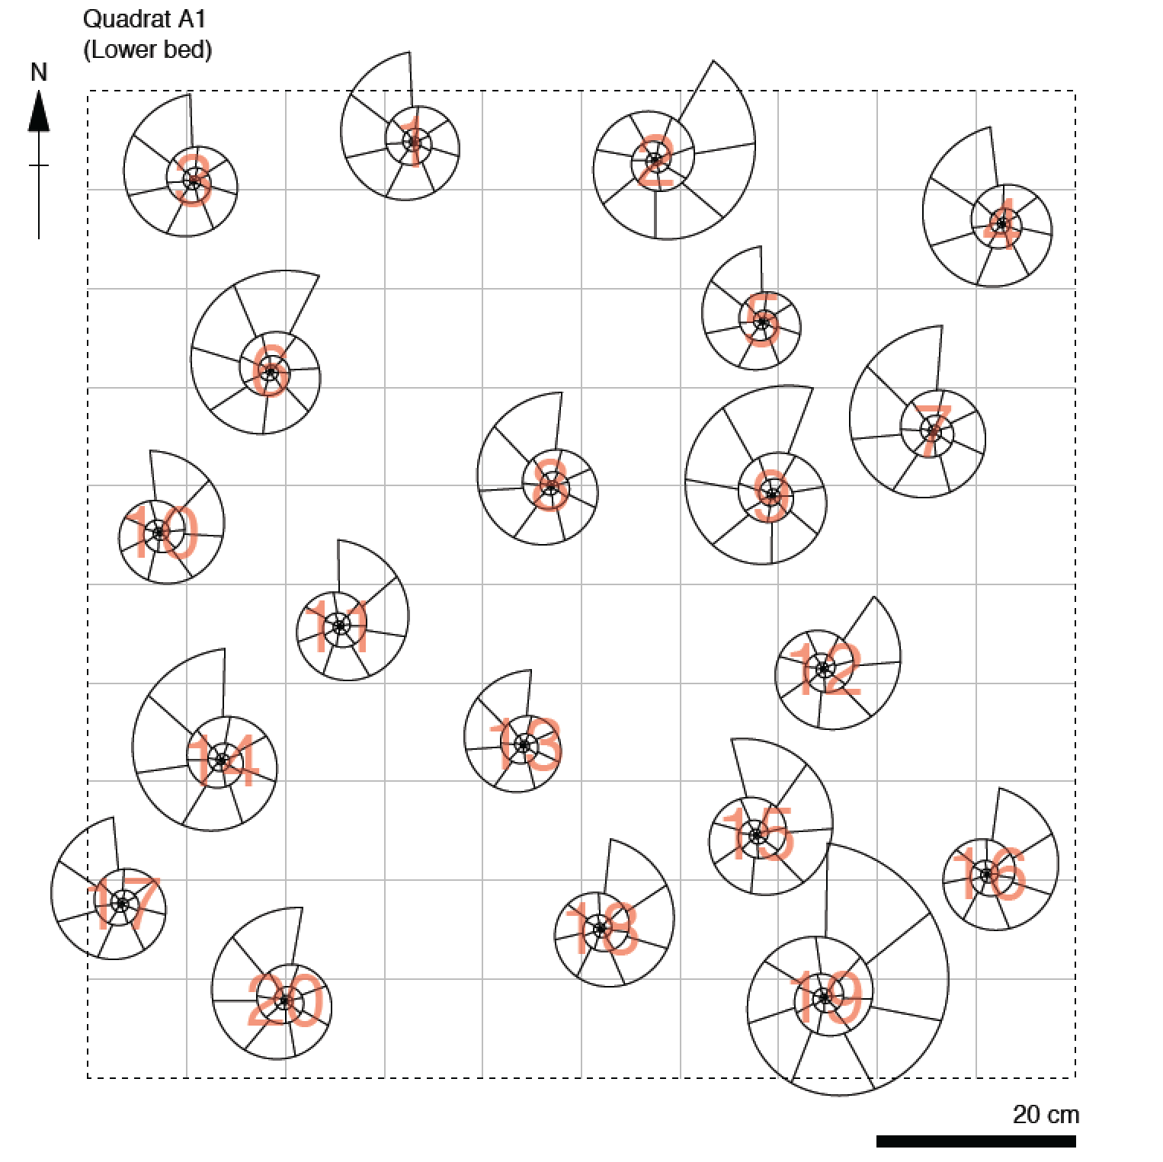
For today’s lecture you will need your quadrat (spares at front)

Slide 2

SOEE1475 Statistics and Data Analysis
Lecture 5: Spatial statistics
Graeme T. Lloyd

Slide 3

Today
Spatial patterns of point distributions
Chi-square test
Nearest neighbour distances

Slide 4
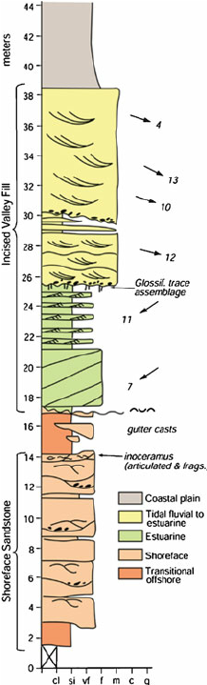
Spatial data in geology
1D

Slide 5
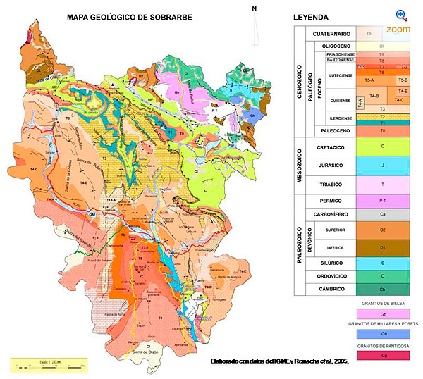
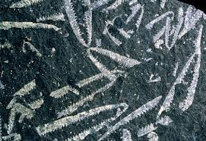
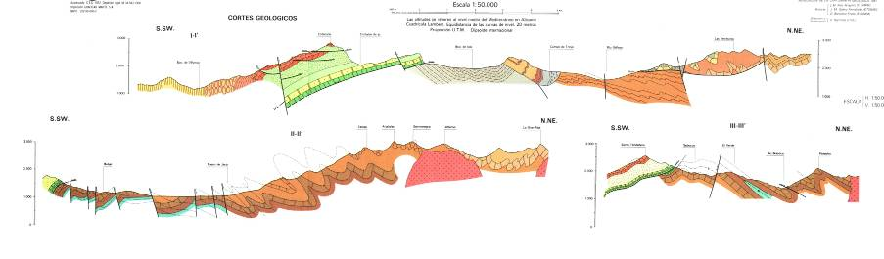
Spatial data in geology
1D
2D

Slide 6
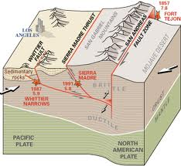
Spatial data in geology
1D
2D
3D

Slide 7
Point distributions

Slide 8
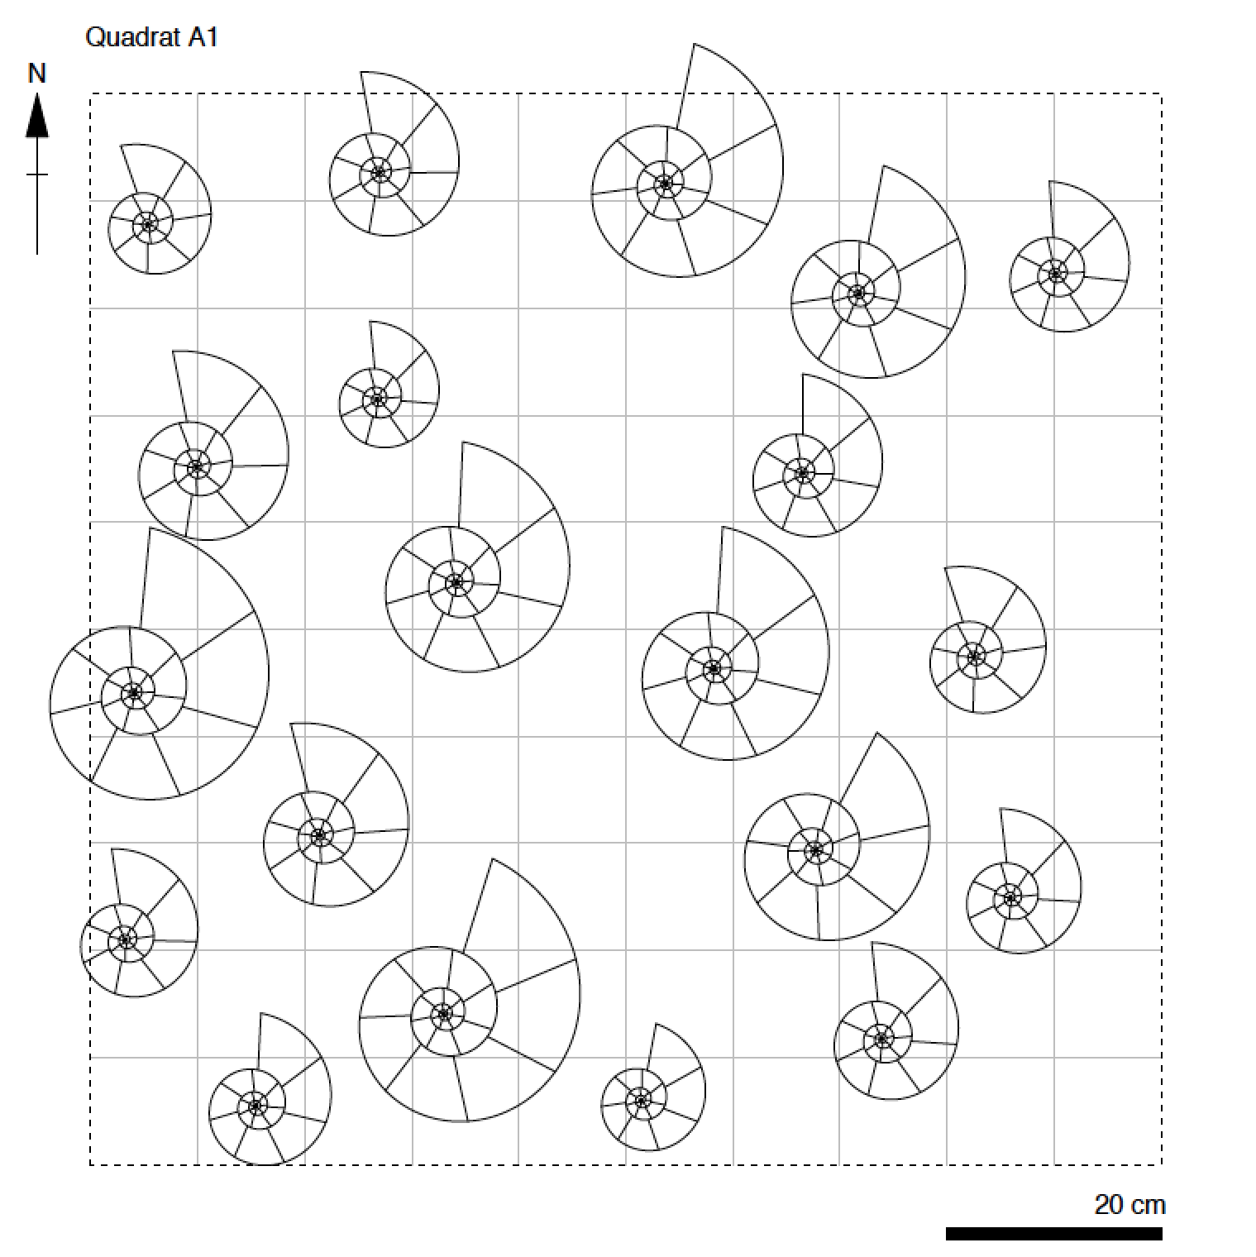
Point distributions

Slide 9
Point distributions

Slide 10
Point distributions
Regular

Slide 11
Point distributions
Regular
Uniform

Slide 12
Point distributions
Regular
Uniform
Random

Slide 13
Point distributions
Regular
Uniform
Random
Clustered

Slide 14
Point distributions
Regular
Uniform
Random
Clustered
Anisotropic

Slide 15
Point distributions
Regular
Uniform
Random
Clustered
Homogeneity
Heterogeneity
Anisotropic

Slide 16
Point distributions
Isotropic
Regular
Uniform
Random
Clustered
Anisotropic
Homogeneity
Heterogeneity
Anisotropic

Slide 17
Point distributions

Slide 18
Point distributions

Slide 19
Point distributions
2
1
1
2
1
4
0
3
1
2
2
1
2
1
2
0

Slide 20
Point distributions
Regular
Uniform
Random
Clustered

Slide 21
Point distributions
Regular
Uniform
Random
Clustered

Slide 22
Exercise – part I

Slide 23
Exercise – part I

Slide 24
Exercise – part I
Regular
Uniform
Random
Clustered

Slide 25
Exercise – part I

Slide 26
Exercise – part I
Q1
Q2
Q3
Q4

Slide 27
Exercise – part I
Q1
Q2
Q1 =
Q2 =
Q3 =
Q4 =
Q3
Q4

Slide 28
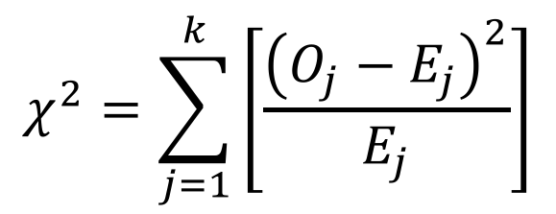
The Chi-squared test – testing for uniform
$$χ^{2}=\sum_{j=1}^{k}{\left[\frac{{\left(O_{j}−E_{j}\right)}^{2}}{E_{j}}\right]}$$

Slide 29
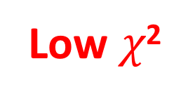
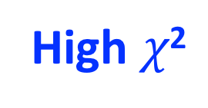
The Chi-squared test – testing for uniform
Low $χ$²
High $χ$²
$$χ^{2}=\sum_{j=1}^{k}{\left[\frac{{\left(O_{j}−E_{j}\right)}^{2}}{E_{j}}\right]}$$

Slide 30
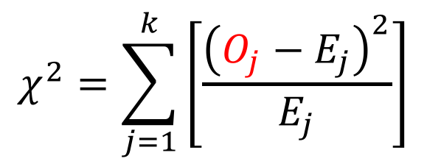
The Chi-squared test – testing for uniform
Low $χ$²
High $χ$²
$$χ^{2}=\sum_{j=1}^{k}{\left[\frac{{\left(O_{j}−E_{j}\right)}^{2}}{E_{j}}\right]}$$

Slide 31
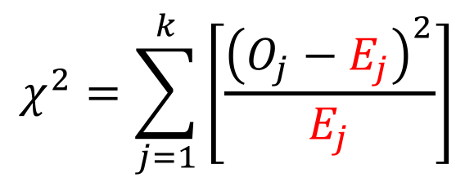
The Chi-squared test – testing for uniform
Low $χ$²
High $χ$²
$$χ^{2}=\sum_{j=1}^{k}{\left[\frac{{\left(O_{j}−E_{j}\right)}^{2}}{E_{j}}\right]}$$

Slide 32
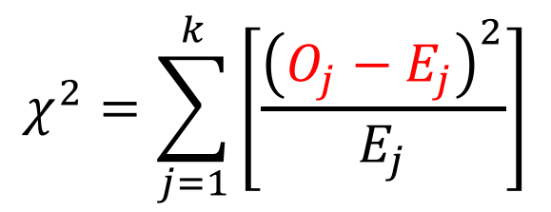
The Chi-squared test – testing for uniform
Low $χ$²
High $χ$²
$$χ^{2}=\sum_{j=1}^{k}{\left[\frac{{\left(O_{j}−E_{j}\right)}^{2}}{E_{j}}\right]}$$

Slide 33
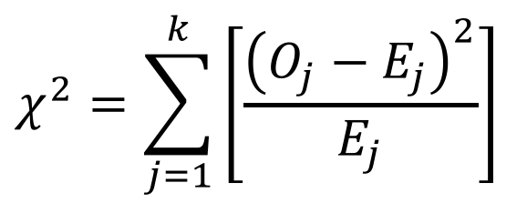
Exercise – part II
$$χ^{2}=\sum_{j=1}^{k}{\left[\frac{{\left(O_{j}−E_{j}\right)}^{2}}{E_{j}}\right]}$$

Slide 34
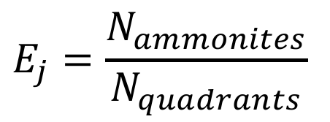
Exercise – part II
$$χ^{2}=\sum_{j=1}^{k}{\left[\frac{{\left(O_{j}−E_{j}\right)}^{2}}{E_{j}}\right]}$$
$$E_{j}=\frac{N_{ammonites}}{N_{quadrants}}$$

Slide 35
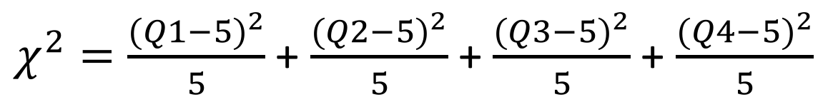
Exercise – part II
$$χ^{2}=\sum_{j=1}^{k}{\left[\frac{{\left(O_{j}−E_{j}\right)}^{2}}{E_{j}}\right]}$$
$$E_{j}=\frac{N_{ammonites}}{N_{quadrants}}$$
$χ^{2}=\frac{{(Q1−5)}^{2}}{5}$ + $\frac{{(Q2−5)}^{2}}{5}$ + $\frac{{(Q3−5)}^{2}}{5}$ + $\frac{{(Q4−5)}^{2}}{5}$

Slide 36
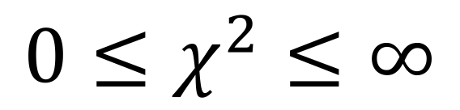
The Chi-squared test – testing for uniform
$${0≤χ}^{2}≤∞$$

Slide 37
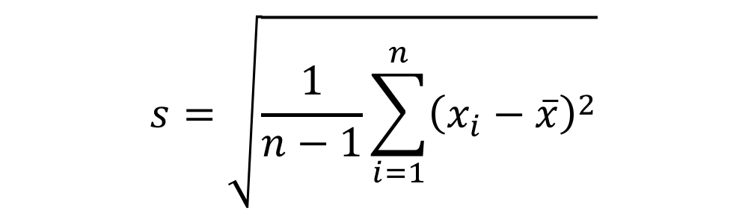

Degrees of freedom
Sample standard deviation
Pearson correlation coefficient
$$s=\sqrt{\frac{1}{n−1}\sum_{i=1}^{n}{{\left(x_{i}−\overline{x}\right)}^{2}}}$$
$$r=\frac{\sum_{i=1}^{n}{(Z_{xi}×Z_{yi})}}{n−1}$$
t-distribution parameter
F-distribution parameters
$$d_{1}=N_{replicates}−1$$
$$v=n−1$$
$$d_{2}=N_{treatments}−1$$

Slide 38
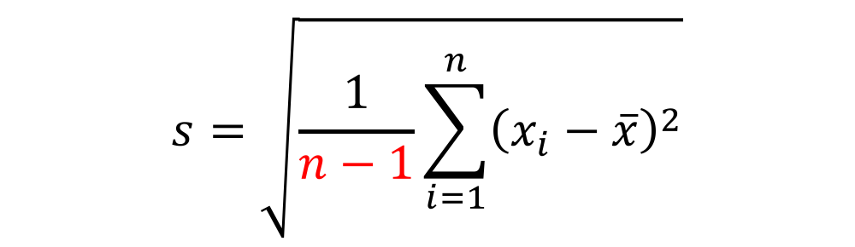

Degrees of freedom
Sample standard deviation
Pearson correlation coefficient
$$s=\sqrt{\frac{1}{n−1}\sum_{i=1}^{n}{{\left(x_{i}−\overline{x}\right)}^{2}}}$$
$$r=\frac{\sum_{i=1}^{n}{(Z_{xi}×Z_{yi})}}{n−1}$$
t-distribution parameter
F-distribution parameters
$$d_{1}=N_{replicates}−1$$
$$v=n−1$$
$$d_{2}=N_{treatments}−1$$

Slide 39
Degrees of freedom

Slide 40
Degrees of freedom

Slide 41
Degrees of freedom

Slide 42
Degrees of freedom

Slide 43
Degrees of freedom

Slide 44
Degrees of freedom

Slide 45
Degrees of freedom

Slide 46
Degrees of freedom
Person 1: Choice
Person 2: Choice
Person 3: Choice
Person 4: Choice
Person 5: Choice
Person 6: Choice
Person 7: No choice

Slide 47
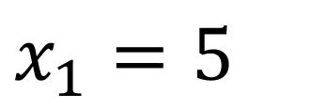
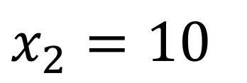
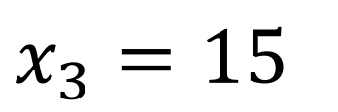
Degrees of freedom
$$x_{1}=5$$
$$x_{2}=10$$
$$x_{3}=15$$

Slide 48
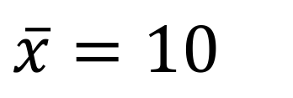
Degrees of freedom
$$x_{1}=5$$
$$x_{2}=10$$
$$\overline{x}=10$$
$$x_{3}=15$$

Slide 49
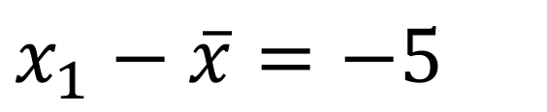
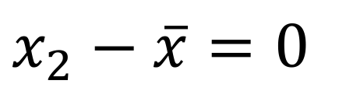
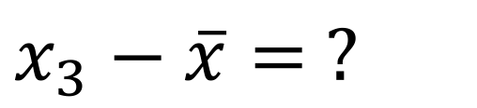
Degrees of freedom
$$x_{1}=5$$
$$x_{1}−\overline{x}=−5$$
$$x_{2}=10$$
$$\overline{x}=10$$
$$x_{2}−\overline{x}=0$$
$$x_{3}=15$$
$$x_{3}−\overline{x}= ?$$

Slide 50
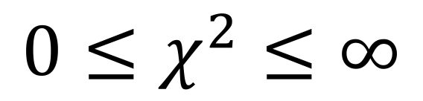
Degrees of freedom
$${0≤χ}^{2}≤∞$$

Slide 51
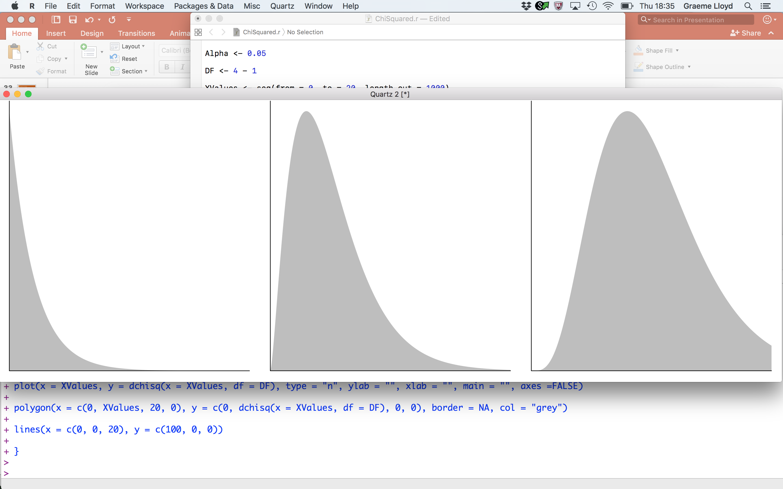
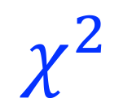
Degrees of freedom
$${0≤χ}^{2}≤∞$$
df = 3 - 1
df = 6 - 1
df = 11 - 1
0
20
0
$$χ^{2}$$
20
0
20

Slide 52
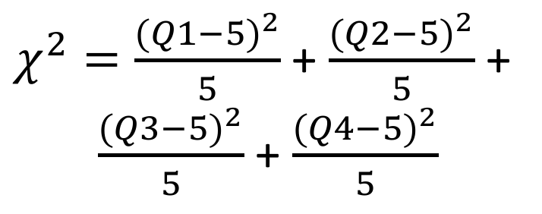
Exercise – part III
$χ^{2}=\frac{{(Q1−5)}^{2}}{5}$ + $\frac{{(Q2−5)}^{2}}{5}$ +
$\frac{{(Q3−5)}^{2}}{5}$ + $\frac{{(Q4−5)}^{2}}{5}$
Q1
Q2
Q3
Q4

Slide 53
Exercise – part III
$χ^{2}=\frac{{(Q1−5)}^{2}}{5}$ + $\frac{{(Q2−5)}^{2}}{5}$ +
$\frac{{(Q3−5)}^{2}}{5}$ + $\frac{{(Q4−5)}^{2}}{5}$
Q1
Q2
Q3
Q4
df = ?

Slide 54
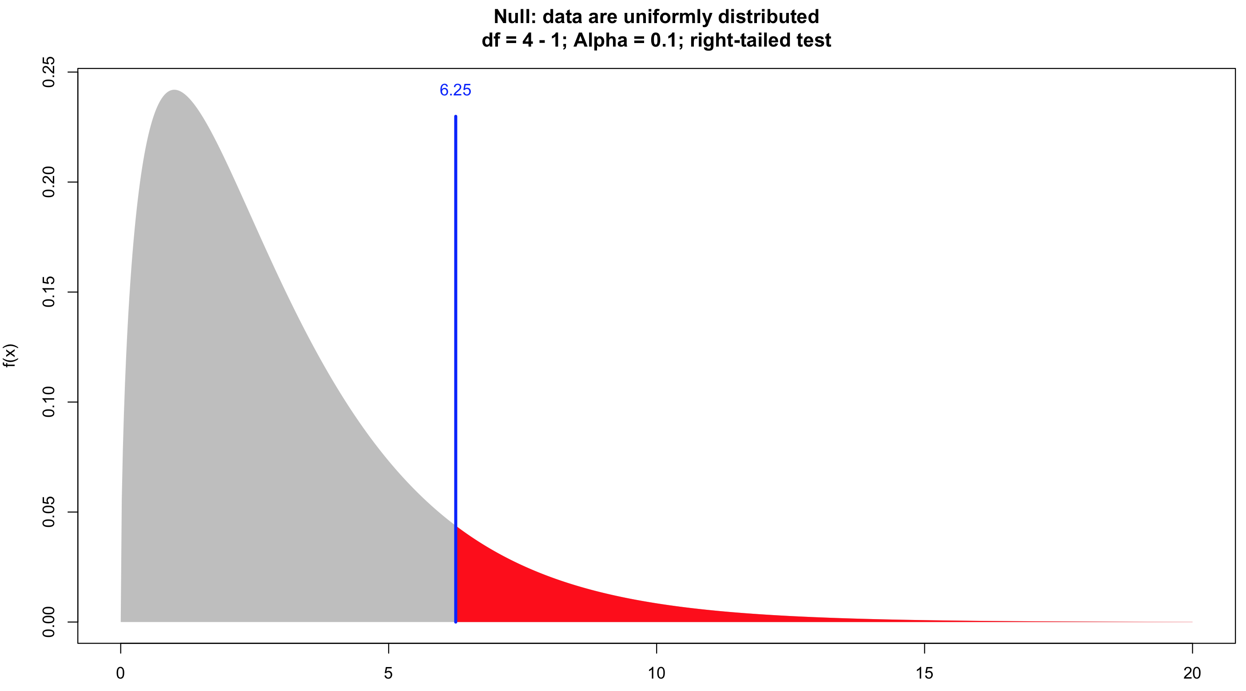
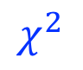
Exercise – part III
$$χ^{2}$$

Slide 55
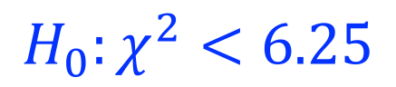

Exercise – part III
$${H_{0}:χ}^{2}<6.25$$
$${H_{1}:χ}^{2}>6.25$$
$$χ^{2}$$

Slide 56
Exercise – part III
Regular
Uniform
Random
Clustered

Slide 57
Poisson distribution – testing for random

Slide 58
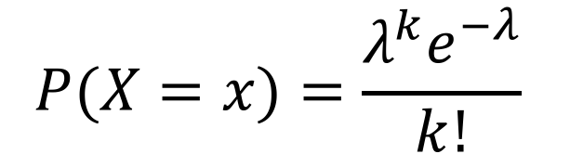

Poisson distribution – testing for random
Discrete probability distribution
$$P(X=x)=\frac{λ^{k}e^{−λ}}{k!}$$
Has single parameter ($λ$), the mean

Slide 59
Poisson distribution – testing for random
Discrete probability distribution
$$P(X=x)=\frac{λ^{k}e^{−λ}}{k!}$$
Has single parameter ($λ$), the mean
Expresses probability of given number of events
Assumes randomness; events can occur in space or time

Slide 60
Poisson distribution – testing for random
Discrete probability distribution
$$P(X=x)=\frac{λ^{k}e^{−λ}}{k!}$$
Has single parameter ($λ$), the mean
Expresses probability of given number of events
Assumes randomness; events can occur in space or time
Good null for random distribution of points in space
I.e., in ammonite example expected N quadrants with k ammonites

Slide 61
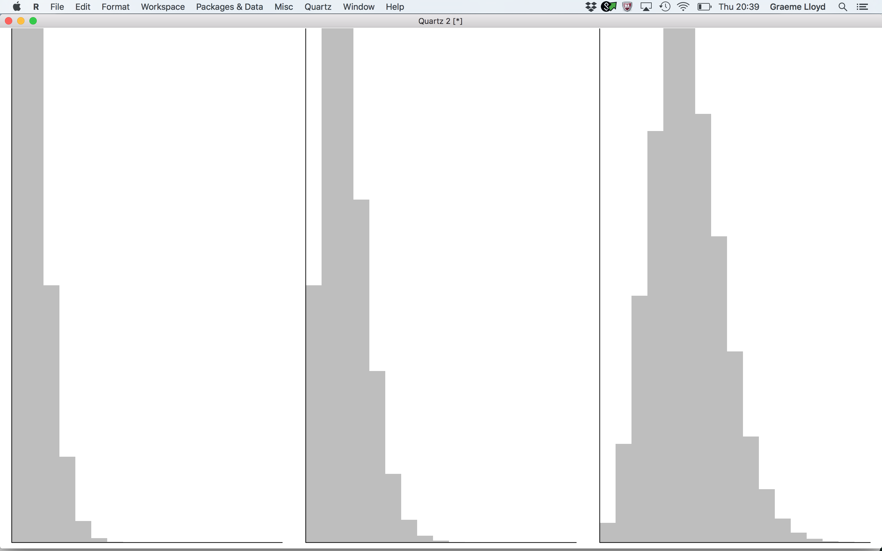




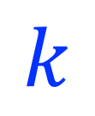
Poisson distribution – testing for random
$$0<λ≤∞$$
$λ$ = 1
$λ$= 2
$λ$ = 5
0
16
0
$$k$$
16
0
16

Slide 62
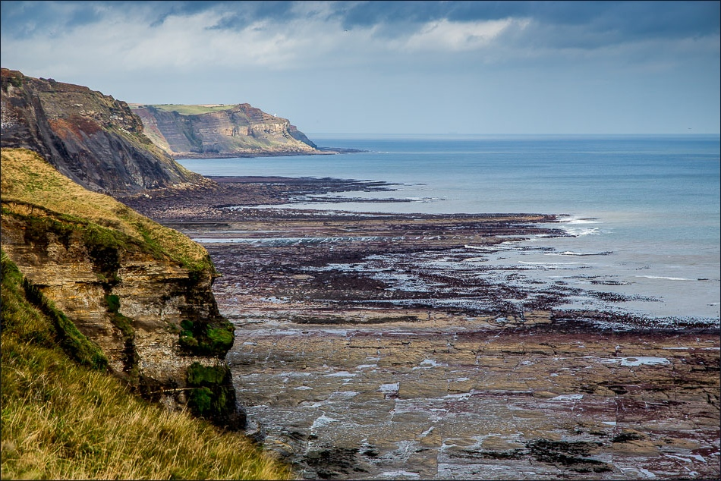
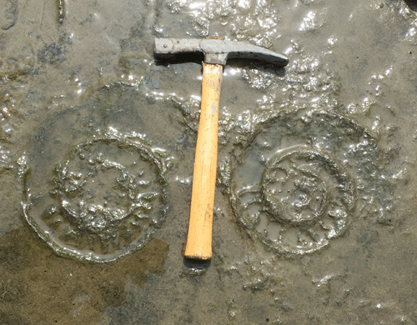
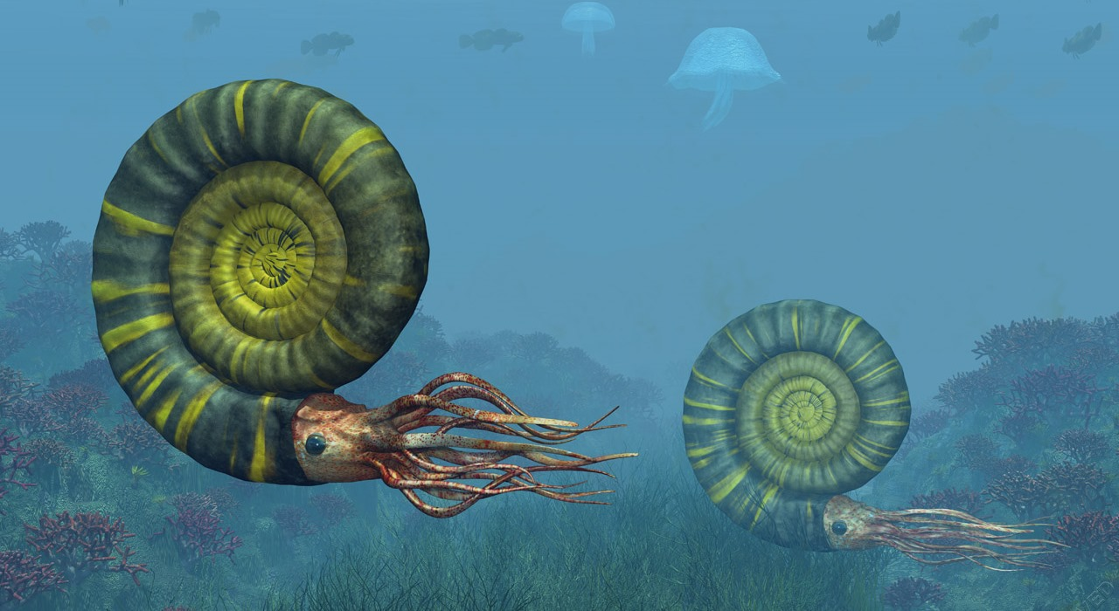
Poisson distribution – testing for random
1
2
3
4
5
6
7
8
9
10
A
B
C
D
E
10m
F
G
H
I
J
10m

Slide 63
Poisson distribution – testing for random
1
2
3
4
5
6
7
8
9
10
A
B
C
D
E
10m
F
G
H
I
J
10m

Slide 64
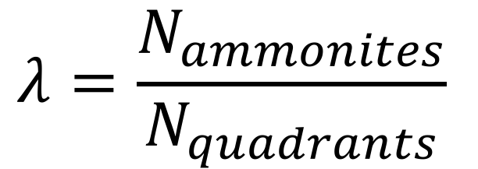
Poisson distribution – testing for random
$$λ=\frac{N_{ammonites}}{N_{quadrants}}$$

Slide 65
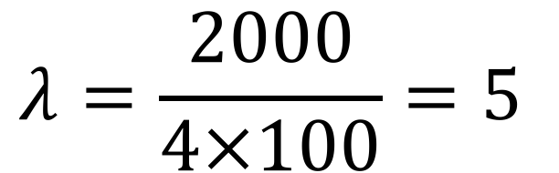
Poisson distribution – testing for random
$$λ=\frac{N_{ammonites}}{N_{quadrants}}$$
$$λ=\frac{2000}{4×100}=5$$

Slide 66
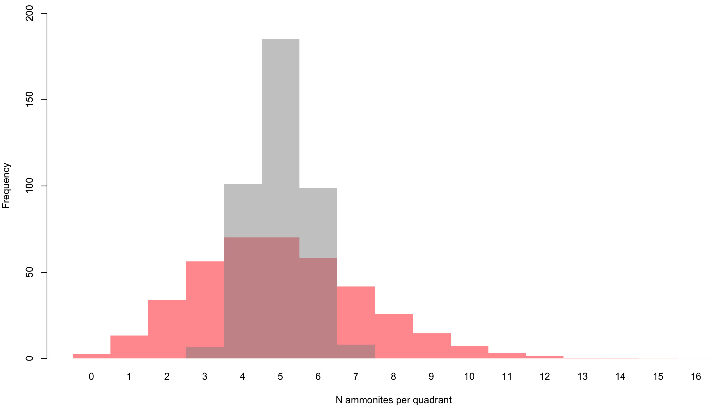
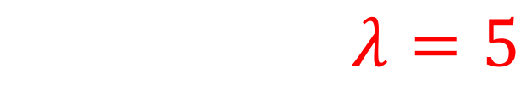
Poisson distribution – testing for random
$$λ=5$$

Slide 67
Poisson distribution – testing for random
$$λ=5$$
O_{j}
E_{j}

Slide 68
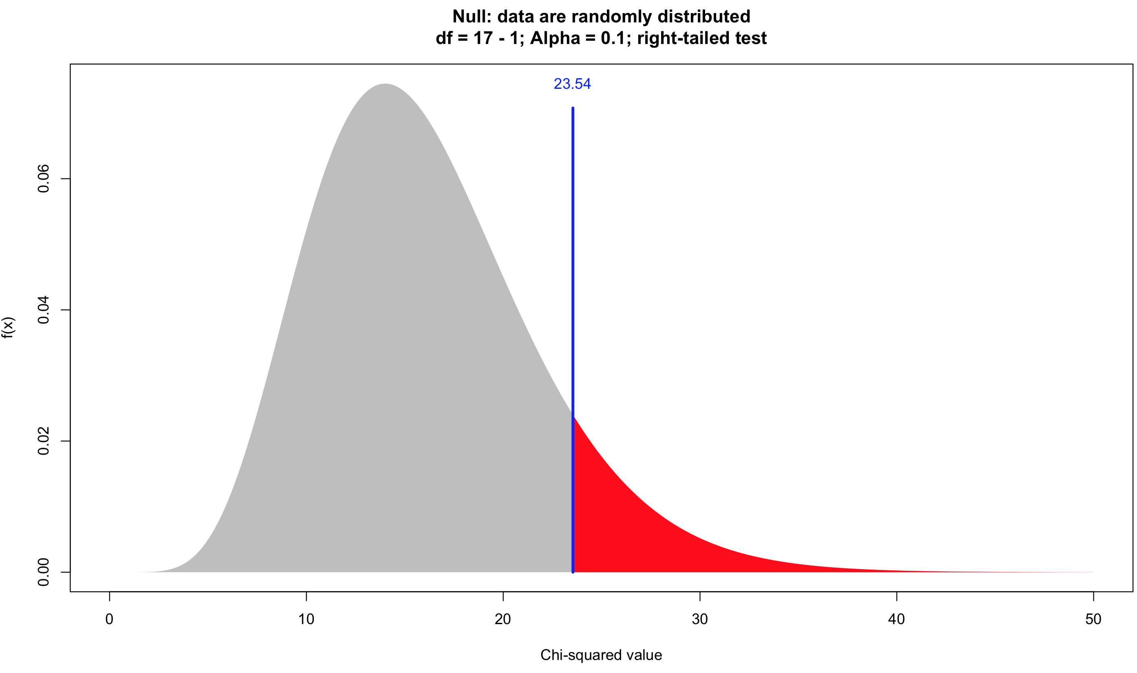
Poisson distribution – testing for random

Slide 69


Poisson distribution – testing for random
$${H_{0}:χ}^{2}<23.54$$
$${H_{1}:χ}^{2}>23.54$$

Slide 70
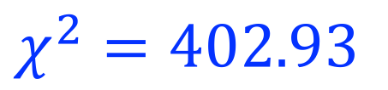
Poisson distribution – testing for random
$${H_{0}:χ}^{2}<23.54$$
$${H_{1}:χ}^{2}>23.54$$
$$χ^{2}=402.93$$

Slide 71
Other tests - nearest neighbour

Slide 72
Other tests - nearest neighbour

Slide 73
Other tests - nearest neighbour

Slide 74
Other tests - nearest neighbour

Slide 75
Other tests - nearest neighbour

Slide 76
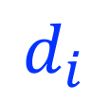
Other tests - nearest neighbour
$$d_{i}$$

Slide 77
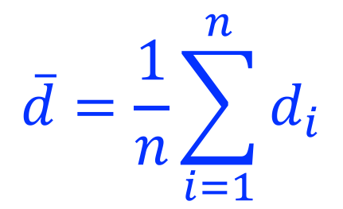
Other tests - nearest neighbour
Mean nearest neighbour distance
$$\overline{d}=\frac{1}{n}\sum_{i=1}^{n}{d_{i}}$$
Captures average distance to nearest point

Slide 78
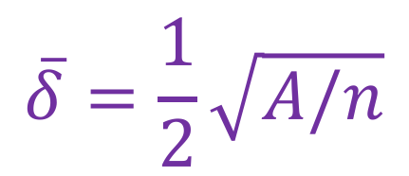
Other tests - nearest neighbour
Mean nearest neighbour distance
$$\overline{d}=\frac{1}{n}\sum_{i=1}^{n}{d_{i}}$$
Captures average distance to nearest point
Expected mean nearest neighbour distance
$$\overline{δ}=\frac{1}{2}\sqrt{A/n}$$
Uses total area (A) and number of objects (n)

Slide 79
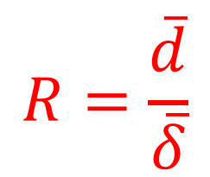
Other tests - nearest neighbour
Mean nearest neighbour distance
$$\overline{d}=\frac{1}{n}\sum_{i=1}^{n}{d_{i}}$$
Captures average distance to nearest point
Expected mean nearest neighbour distance
$$\overline{δ}=\frac{1}{2}\sqrt{A/n}$$
Uses total area (A) and number of objects (n)
Nearest neighbour statistic
$$R=\frac{\overline{d}}{\overline{δ}}$$
Varies from 0 to 2.15

Slide 80
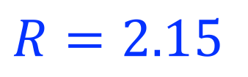
Other tests - nearest neighbour
Nearest neighbour statistic
Regular
$$R=2.15$$

Slide 81

Other tests - nearest neighbour
Nearest neighbour statistic
Regular
Uniform
$$R=2.15$$
$$2.15>R>1$$

Slide 82

Other tests - nearest neighbour
Nearest neighbour statistic
Regular
Uniform
Random
$$R=2.15$$
$$2.15>R>1$$
$$R≈1$$

Slide 83

Other tests - nearest neighbour
Nearest neighbour statistic
Regular
Uniform
Random
Clustered
$$R=2.15$$
$$2.15>R>1$$
$$R≈1$$
$$R<1$$

Slide 84
3D regression
y
x

Slide 85

3D regression
y
z
y
x
x

Slide 86

3D regression
Planes
$$z=ax+by+c$$
3D equivalent of straight line

Slide 87
3D regression
Planes
$$z=ax+by+c$$
3D equivalent of straight line
Domes/bowls
$$z=ax+by+{cx}^{2}+{dy}^{2}+exy+f$$
3D equivalent of (simple) curvilinear

Slide 88
3D regression
Planes
$$z=ax+by+c$$
3D equivalent of straight line
Domes/bowls
$$z=ax+by+{cx}^{2}+{dy}^{2}+exy+f$$
3D equivalent of (simple) curvilinear
More complex
$$z=ax+by+{cx}^{2}+{dy}^{2}+{ex}^{3}…$$
Capture more complex landscapes

Slide 89

The dangers of extrapolation
Source: xkcd

